Slide 1

Hyro Team 28
Josh Asher
Jason Klindtworth
Layne nolli

Slide 2
Recap of Previous Term
We have been requested to design remote operation and data visualization software for a hybrid rocket.
The system has two components, one onboard the rocket and one a traditional computer on the ground.
Important goals include remote filling, arming, and launch. Along with visualizing data that is collected from onboard sensors.

Slide 3
What is a hybrid rocket?
A rocket with a motor that has both solid and liquid fuel.
The liquid fuel is called the oxidizer and is housed in a tank that is filled right before launch of the rocket.
The solid fuel is held in the combustion chamber.
The oxidizer is injected through the center of the solid fuel
Hybrid rockets have the unique capability of being throttled.

Slide 4
Research performed
Software design – Python
Hard design – Beaglebone, 2 Xbee to usb breakout board (radio transceiver), accelerometer, barometric readings, temperature readings.
We might be implementing GPS in the future if we have time.

Slide 5
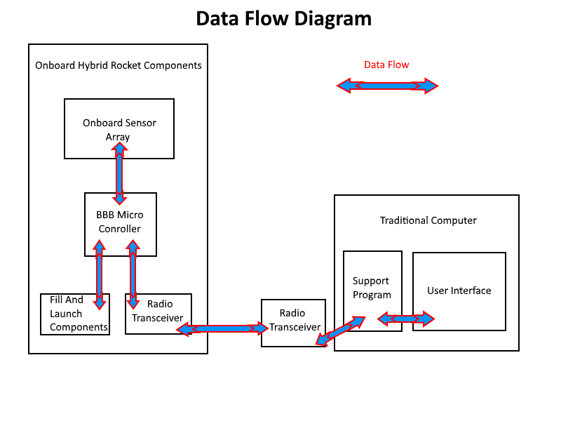
Requirements Document – Data Flow

Slide 6
Hyro alpha code progress

Slide 7
Layout of User Interface

Slide 8
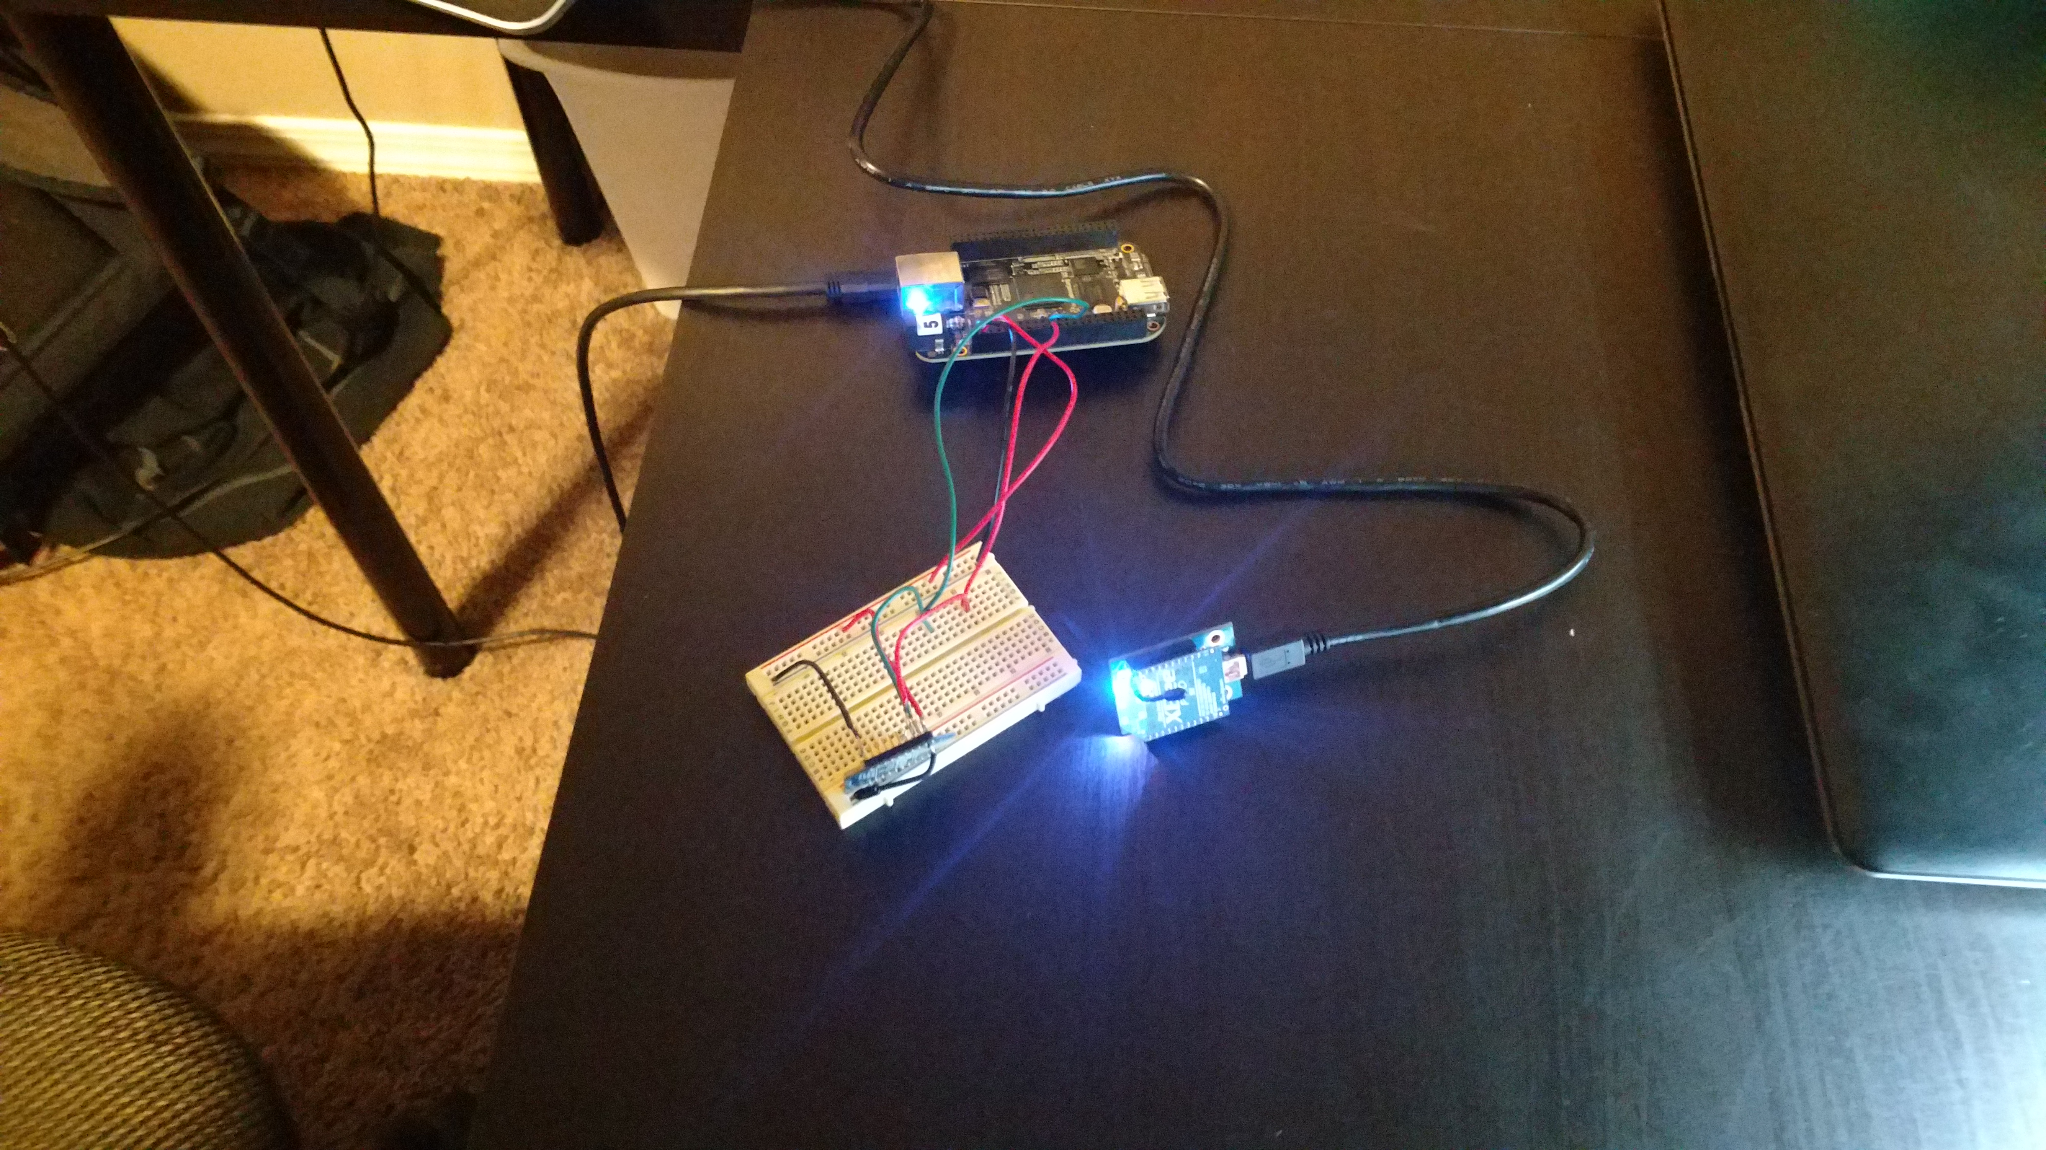
Current hardware setup

Slide 9
Moving Forward – improving layout
Graphical layout
Functionality
Figure out what elements we are going to need in order to perform required function
GPS – stretch goal

Slide 10
Moving Forward – Team interaction
Figure out responsibilities of each disciplinary team in the future of the project to prevent redundancy and to make sure everything is going to get done
Make sure the different sub teams have matching code protocol in order to make communication between the devices smooth
Monitoring progress from mechanical team to make sure their requirements are met

Slide 11
Moving Forward – EXPO
Plans for the poster
Plans for a live example for demonstration purpose

